Slide 1

Forecasting temperature using stl-Arima:
A Study on Four Indian Cities
Presented by:
Akash Singh
Asima Ray Choudhury
Koyel Chakraborty
Rimi Biswas
Shreya Bhuiya
Supervised by:
Taranga Mukherjee
&
Mayukh Bhattacharya
Term Project Presentation (Semester: I)
Maulana Abul Kalam Azad University of Technology

Slide 2
Introduction
Most of our daily life decisions are affected by weather conditions and weather patterns. The term weather refers to the temporary conditions of the atmosphere. The six main components of weather are temperature, atmospheric pressure, wind humidity, precipitation, and cloudiness. But in this project our only focus is the temperature dynamics with respect to time.
Temperature:
It refers to how hot or cold the atmosphere is.
Time Series Data :
The term “time series data” refers to a set of observations of a variable collected sequentially over time. In time series analysis, we seek to get information from the data by determining the best model to represent the data.

Slide 3
Objectives
To study the trend and seasonality of weather temperature from a spatio-temporal perspective.
To fit efficient time-series models for predicting the future temperature.
To forecast the temperature of 2022 by using the fitted model.

Slide 4
Source of Data
Secondary data have been collected from National Centers for Environmental Information of National Oceanic and Atmospheric Administration (NOAA).
The dataset contains daily temperature data of the time period 1995-2021 for Kolkata, Mumbai, Delhi and Chennai. For training, the data of 1995-2019 have been used and the rest have been used for validation purpose.
We have changed the frequency into monthly format for our analysis.

Slide 5

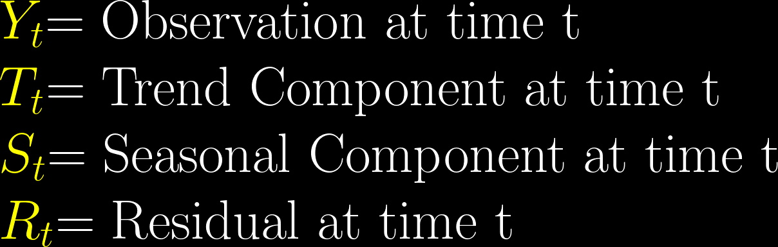
Methodology
About Time Series Decomposition
where,

Slide 6
Methodology
STL stands for Seasonal Trend Decomposition using LOESS (Locally Estimated Scatterplot Smoothing)
ARIMA stands for Autoregressive Integrated Moving Average Method
Seasonality using STL
Trend & Residual using ARIMA
STL-ARIMA

Slide 7
Methodology
Why STL?
It is more robust method (than Naive decomposition) for separating seasonal component from Time Series data.
The seasonal components are not fixed to be constant, rather STL allows them to change over time.

Slide 8
Methodology
About STL (After Cleveland et al., 1990)
Detrend
LOESS on Cycle Subseries
Low-Pass Filter
LOESS estimate of Trend
Deseasonalize
Detrend Cycle Subseries
Inner Loop:
Outer Loop: Weight data points for a robust fit.

Slide 9
Methodology
Why ARIMA?
It incorporates both autoregressive and moving average terms to model time series data.
The ‘Integrated’ part of it takes care of non-stationarity, if present.

Slide 10
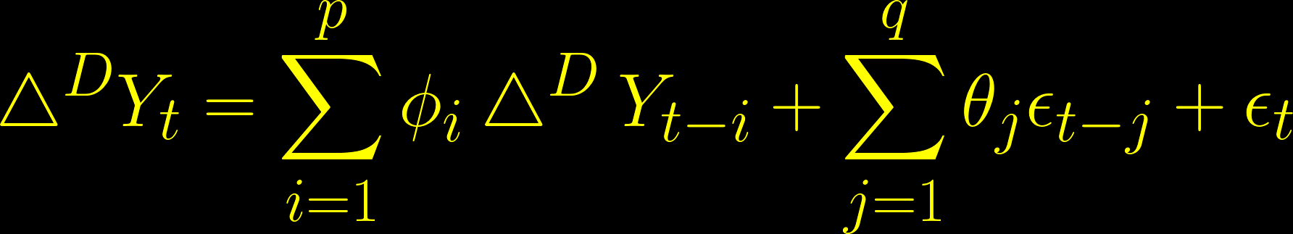
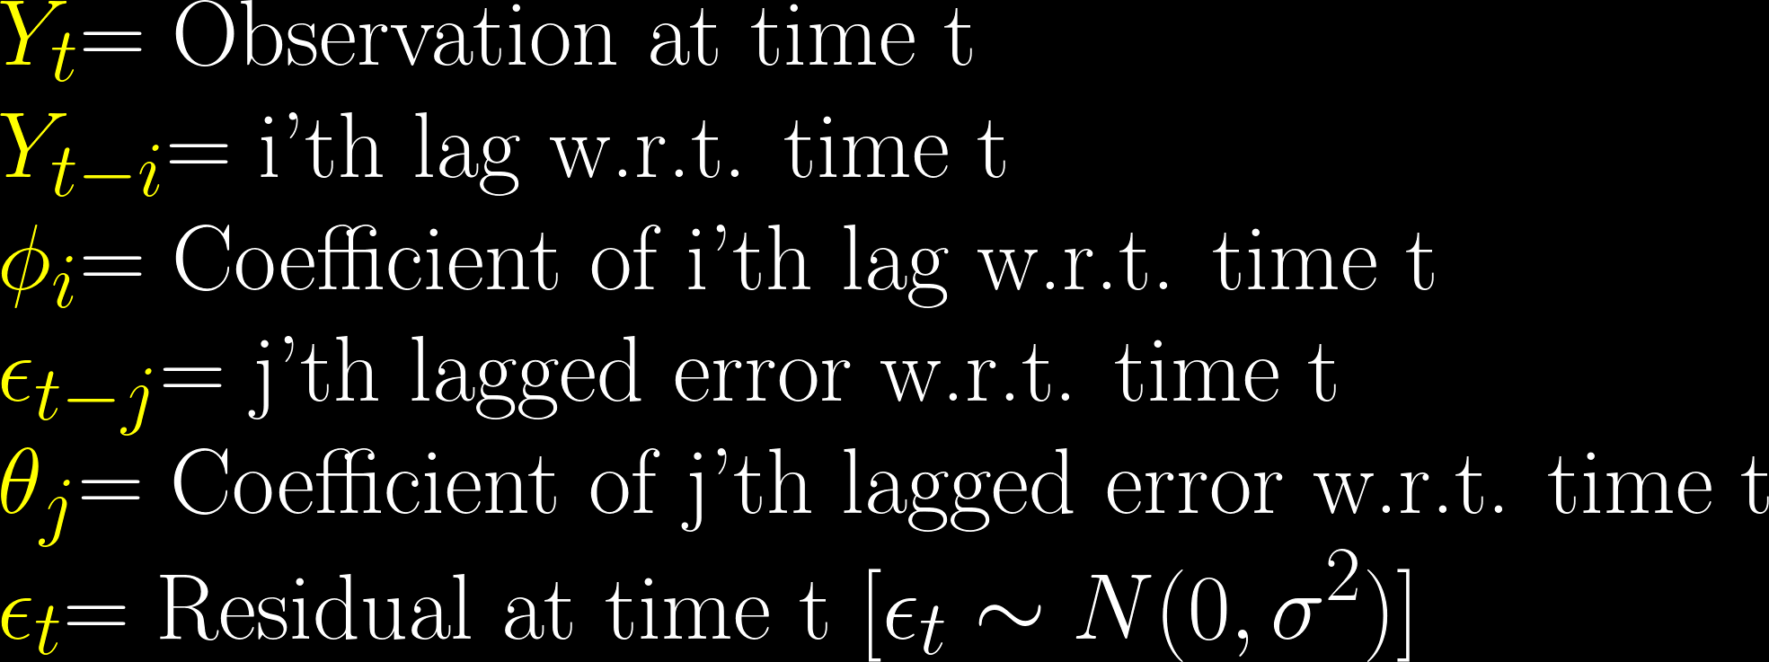
Methodology
About ARIMA (p, D, q)
where,
p = Number of Lags Considered
D = Order of Difference Operator
q = Number of Lagged Errors Considered

Slide 11
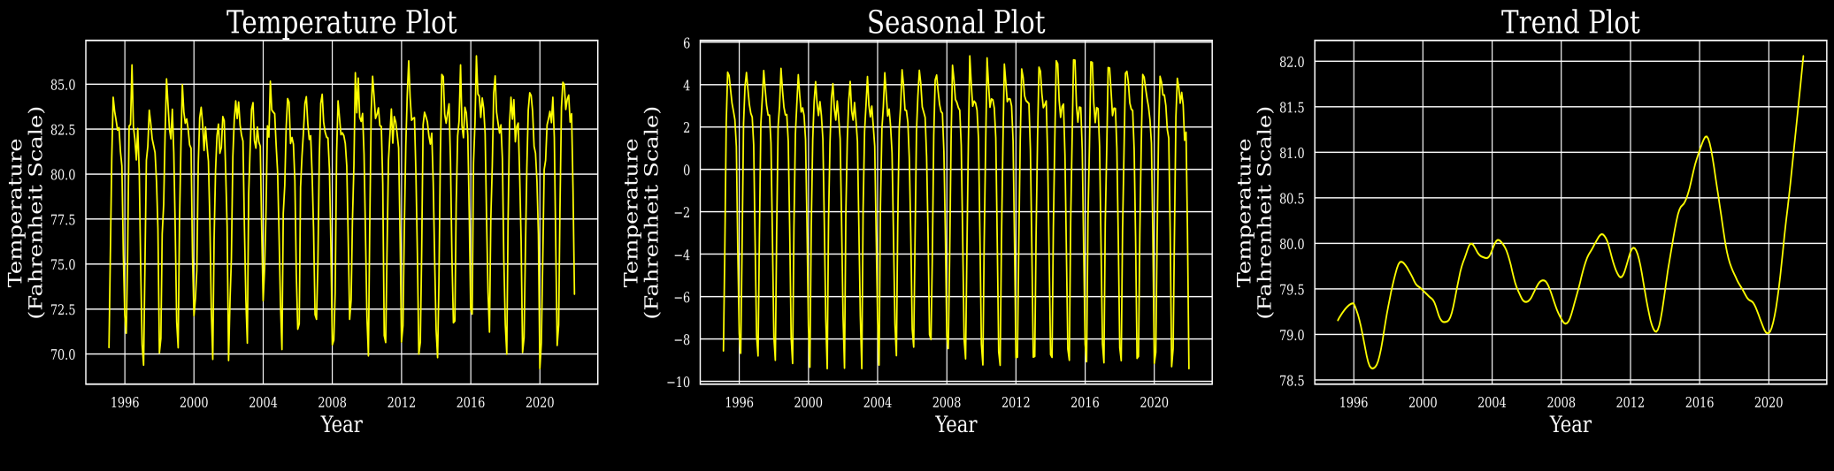
Results and Discussion
Kolkata
Exploratory Data Analysis

Slide 12
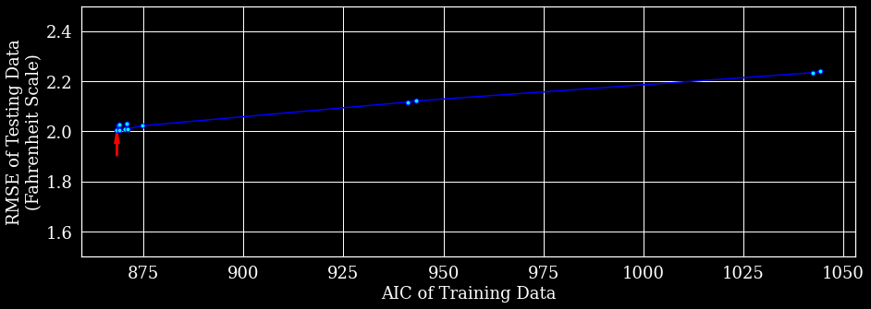
Results and Discussion
Kolkata
Selecting the ARIMA Orders
Result of ADF Test for First Difference Series:
Test Statistic:
-5.910
p-Value:
0.000
ARIMA(0,1,1)

Slide 13
Results and Discussion
Kolkata
Model Specification
Dep. Variable: | y | No. Observations: | 300
Model: | ARIMA(0, 1, 1) | Log Likelihood: | -432.2
Date: | Thu, 17 Feb 2022 | AIC : | 868.33
Time: | 19:19:22 | BIC : | 875.73
Sample: | 01-31-1995 | HQIC : | 871.3
 | to 12-31-2019
Covariance Type: | opg
STL Configuration
Period: | 12 | Trend Length: | 23
Seasonal: | 7 | Trend deg: | 1
Seasonal deg: | 1 | Trend jump: | 1
Seasonal jump: | 1 | Low pass: | 13
Robust: | True | Low pass deg: | 1
 | coef | std err | z | P>|z| | [0.025 | 0.975]
ma.L1 | -0.843 | 0.034 | -25.06 | 0 | -0.908 | -0.777
sigma2 | 1.0499 | 0.054 | 19.332 | 0 | 0.943 | 1.156
Ljung-Box (L1) (Q): | 1.05 | Jarque-Bera (JB): | 113.02
Prob(Q): | 0.31 | Prob(JB): | 0
Heteroskedasticity (H): | 0.77 | Skew: | -0.08
Prob(H) (two-sided): | 0.19 | Kurtosis: | 6.01

Slide 14
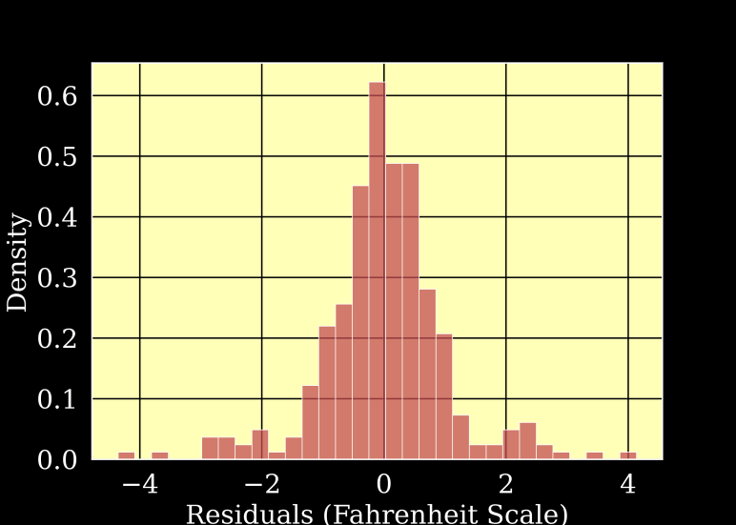
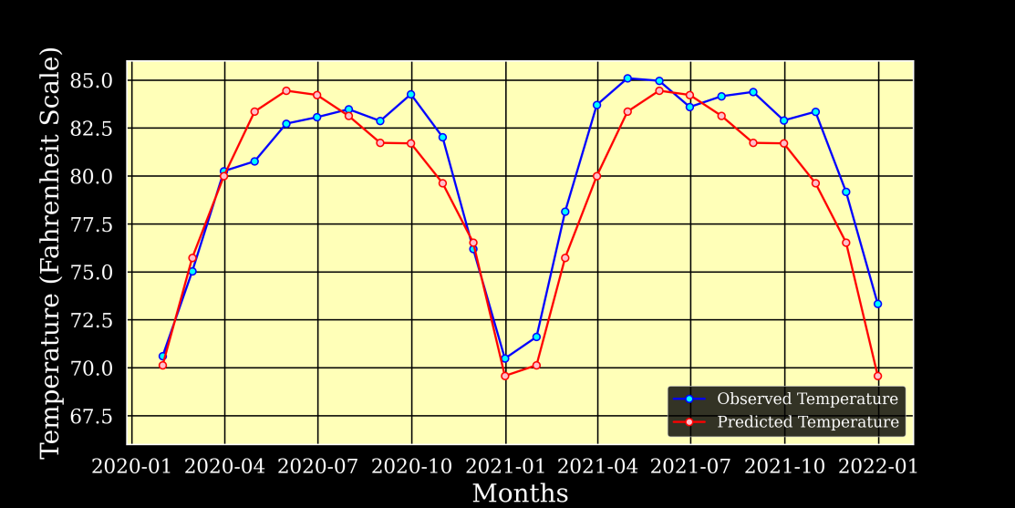
Results and Discussion
Kolkata
Model Performance
Histogram of Residuals
(Training Set)
Prediction Performance
(Testing Set)
RMSE: 2.004

Slide 15
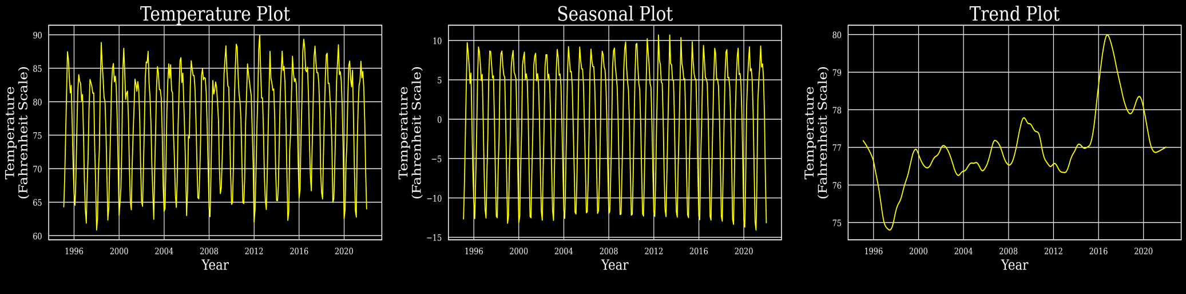
Results and Discussion
Delhi
Exploratory Data Analysis

Slide 16
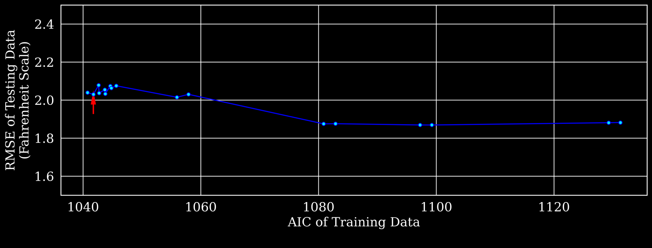
Results and Discussion
Delhi
Selecting the ARIMA Orders
Result of ADF Test for First Difference Series:
Test Statistic:
-17.736
p-Value:
0.000
ARIMA(0,1,2)

Slide 17
Results and Discussion
Delhi
Model Specification
Dep. Variable: | y | No. Observations: | 300
Model: | ARIMA(0, 1, 2) | Log Likelihood : | -517.9
Date: | Sat, 19 Feb 2022 | AIC : | 1041.7
Time: | 09:03:14 | BIC : | 1052.8
Sample: | 01-31-1995 | HQIC : | 1046.2
 | to 12-31-2019
Covariance Type: | opg
STL Configuration
Period: | 12 | Trend Length: | 23
Seasonal: | 7 | Trend deg: | 1
Seasonal deg: | 1 | Trend jump: | 1
Seasonal jump: | 1 | Low pass: | 13
Robust: | True | Low pass deg: | 1
 | coef | std err | z | P>|z| | [0.025 | 0.975]
ma.L1 | -0.58 | 0.05 | -11.69 | 0 | -0.677 | -0.483
ma.L2 | -0.23 | 0.056 | -4.094 | 0 | -0.34 | -0.12
sigma2 | 1.8644 | 0.095 | 19.597 | 0 | 1.678 | 2.051
Ljung-Box (L1) (Q): | 0.02 | Jarque-Bera (JB): | 167.68
Prob(Q): | 0.88 | Prob(JB): | 0
Heteroskedasticity (H): | 1.11 | Skew: | 0.59
Prob(H) (two-sided): | 0.59 | Kurtosis: | 6.47

Slide 18
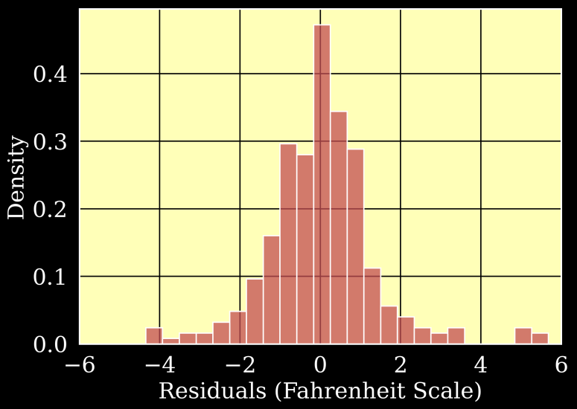
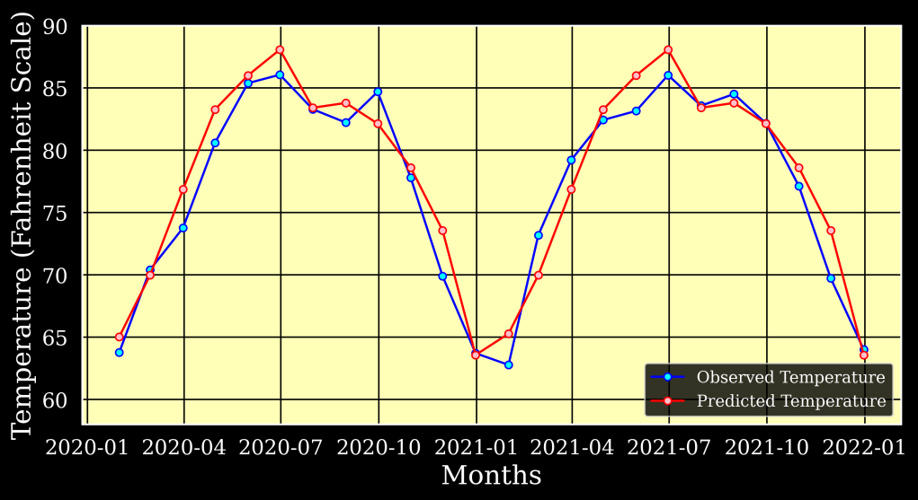
Results and Discussion
Delhi
Model Performance
Histogram of Residuals
(Training Set)
Prediction Performance
(Testing Set)
RMSE: 2.030

Slide 19
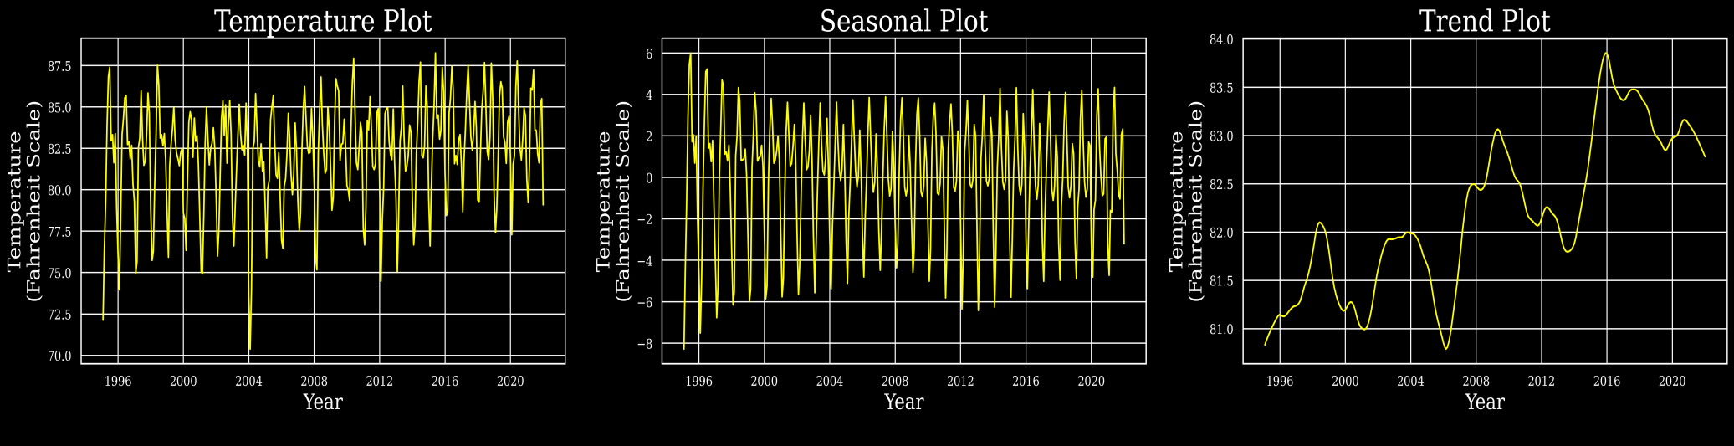
Results and Discussion
Mumbai
Exploratory Data Analysis

Slide 20
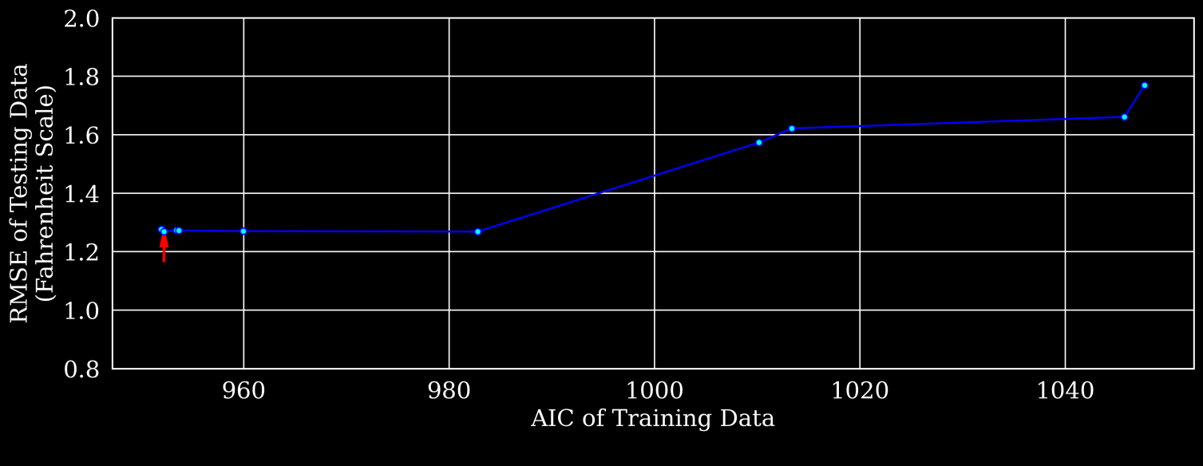
Results and Discussion
Mumbai
Selecting the ARIMA Orders
Result of ADF Test for First Difference Series:
Test Statistic:
-8.806
p-Value:
0.000
ARIMA(1,1,1)

Slide 21
Results and Discussion
Mumbai
Model Specification
Dep. Variable: | y | No. Observations: | 300
Model: | ARIMA(1, 1, 1) | Log Likelihood | -473.1
Date: | Sat, 19 Feb 2022 | AIC : | 952.23
Time: | 16:48:12 | BIC : | 963.33
Sample: | 01-31-1995 | HQIC : | 956.67
 | to 12-31-2019
Covariance Type: | opg
STL Configuration
Period: | 12 | Trend Length: | 23
Seasonal: | 7 | Trend deg: | 1
Seasonal deg: | 1 | Trend jump: | 1
Seasonal jump: | 1 | Low pass: | 13
Robust: | True | Low pass deg: | 1
 | coef | std err | z | P>|z| | [0.025 | 0.975]
ar.L1 | 0.3644 | 0.042 | 8.619 | 0 | 0.282 | 0.447
ma.L1 | -0.948 | 0.022 | -43.52 | 0 | -0.99 | -0.905
sigma2 | 1.3791 | 0.07 | 19.569 | 0 | 1.241 | 1.517
Ljung-Box (L1) (Q): | 0.12 | Jarque-Bera (JB): | 153.6
Prob(Q): | 0.73 | Prob(JB): | 0
Heteroskedasticity (H): | 0.99 | Skew: | -0.21
Prob(H) (two-sided): | 0.96 | Kurtosis: | 6.49

Slide 22
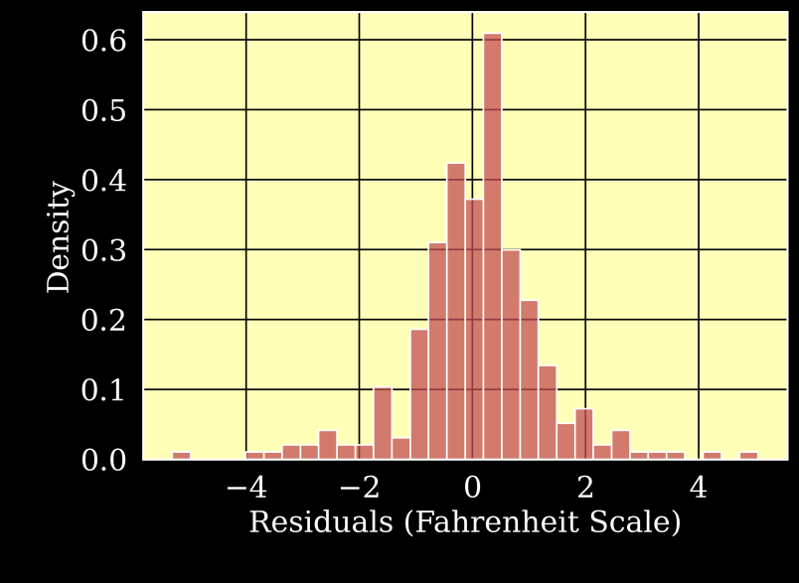
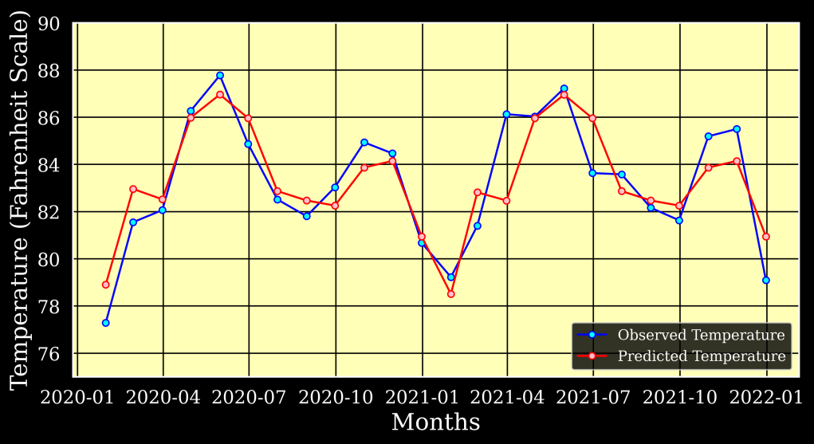
Results and Discussion
Mumbai
Model Performance
Histogram of Residuals
(Training Set)
Prediction Performance
(Testing Set)
RMSE: 1.269

Slide 23
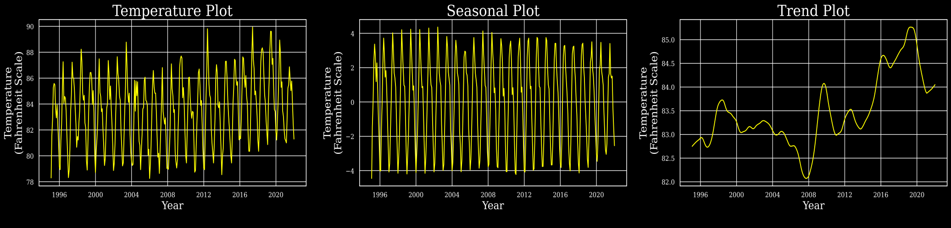
Results and Discussion
Chennai
Exploratory Data Analysis

Slide 24
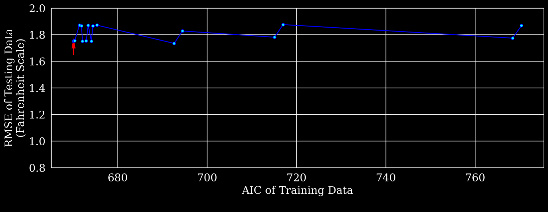
Results and Discussion
Chennai
Selecting the ARIMA Orders
Result of ADF Test for First Difference Series:
ARIMA(1,1,1)
Test Statistic:
-6.088
p-Value:
0.000

Slide 25
Results and Discussion
Chennai
Model Specification
Dep. Variable: | y | No. Observations: | 300
Model: | ARIMA(1, 1, 1) | Log Likelihood | -332.1
Date: | Sun, 20 Feb 2022 | AIC : | 670.12
Time: | 07:01:25 | BIC : | 681.22
Sample: | 01-31-1995 | HQIC : | 674.56
 | to 12-31-2019
Covariance Type: | opg
STL Configuration
Period: | 12 | Trend Length: | 23
Seasonal: | 7 | Trend deg: | 1
Seasonal deg: | 1 | Trend jump: | 1
Seasonal jump: | 1 | Low pass: | 13
Robust: | True | Low pass deg: | 1
 | coef | std err | z | P>|z| | [0.025 | 0.975]
ar.L1 | 0.1347 | 0.077 | 1.758 | 0.079 | -0.015 | 0.285
ma.L1 | -0.768 | 0.051 | -14.91 | 0 | -0.869 | -0.667
sigma2 | 0.5384 | 0.032 | 16.867 | 0 | 0.476 | 0.601
Ljung-Box (L1) (Q): | 0.01 | Jarque-Bera (JB): | 73.24
Prob(Q): | 0.94 | Prob(JB): | 0
Heteroskedasticity (H): | 0.95 | Skew: | -0.42
Prob(H) (two-sided): | 0.79 | Kurtosis: | 5.27

Slide 26
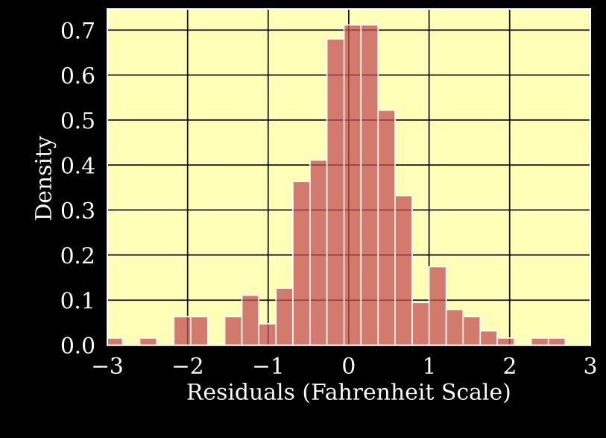
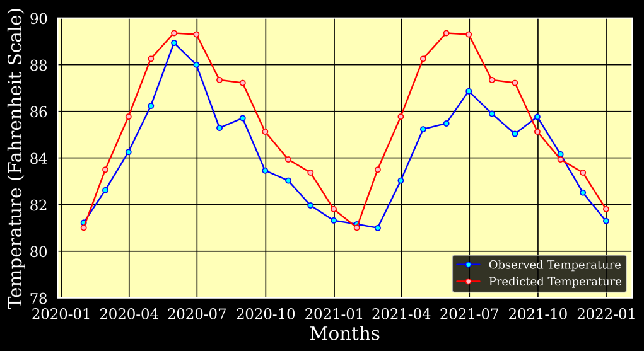
Results and Discussion
Chennai
Model Performance
Histogram of Residuals
(Training Set)
Prediction Performance
(Testing Set)
RMSE: 1.751

Slide 27
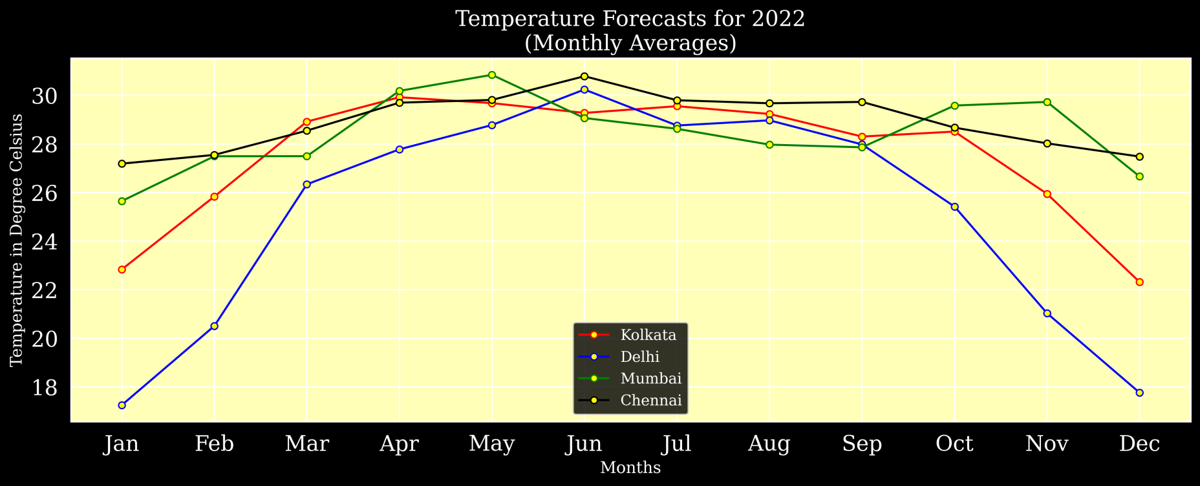
Results and Discussion
Forecasts for 2022

Slide 28
Conclusion
Thus, we have successfully forecasted the temperature of the four cities under study using the STL-ARIMA methodology. The prediction performance is quite satisfactory even without incorporating any exogenous variable that could possibly influence temperature in future. The benefits of such forecast extend widely across the economy. While much has been accomplished in providing nearly-accurate temparature forecasts, there remains much room for further improvement.

Slide 29
Selected References
Books and Papers
Cleveland, R. B., Cleveland, W. S., McRae, J. E., & Terpenning, I. (1990). STL: A seasonal-trend decomposition. J. Off. Stat, 6(1), 3-73.
Hyndman, R. J., & Athanasopoulos, G. (2018). Forecasting: principles and practice. OTexts.
https://www.ncei.noaa.gov/
https://www.statsmodels.org/
Web Links

Slide 30
Thank You

